Slide 1

WELCOME

Slide 2
Introduction
To
Our
Project...

Slide 3
Theme: Personal Branding
Problem Name: Portfolio: Web App for Creating and Showcasing Digital Portfolios
Participants-
Aary, Chirag, Siddhi, Shweta.

Slide 4
Portfolio...
It is a collection of work that showcases your skills , accomplishments & experience in a field .
It serves as a visual representation of your abilities.
A concise overview of your professional history, education & relevant experience.

Slide 5
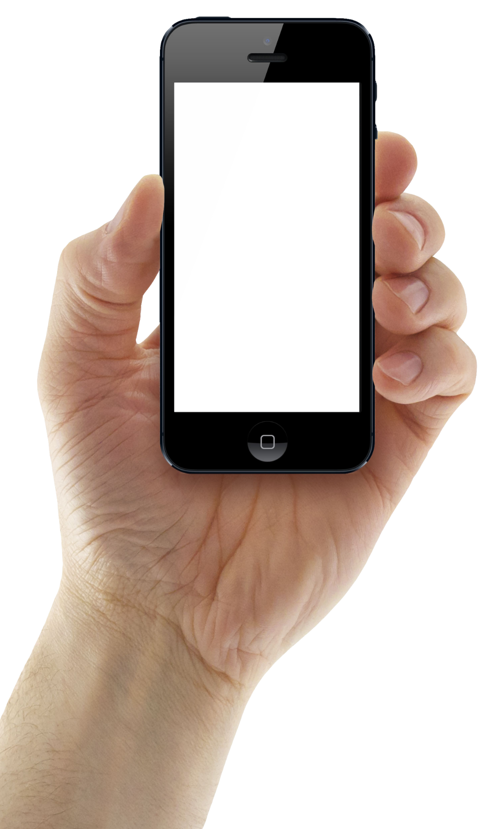

Portfolio
Hub
This Photo by Unknown Author is licensed under CC BY-NC

Slide 6
Sources we used to make our project...
Chrome
Blackbox
GitHub

Slide 7
Why Have A Portfolio.
Demonstrates skills
Personal Branding
Enhances job applications
Attracts clients

Slide 8
Languages we used ...
Html
Css
Javascript

Slide 9
Thank you !

